Slide 1
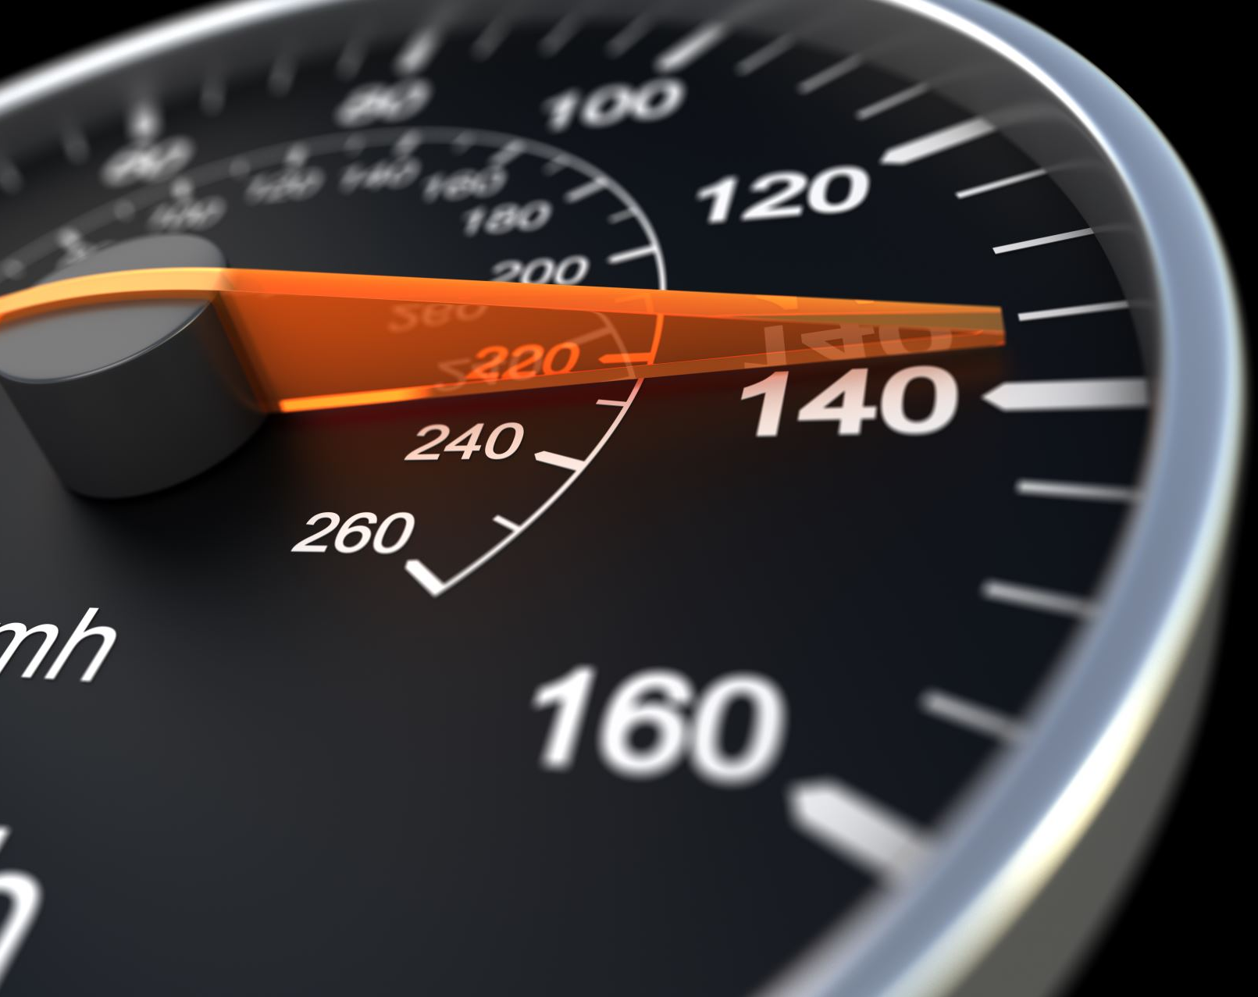
COHORT INTERNET SPEED VS NATIONAL INTERNET SPEED REPORT
BY SANNA AJMAL

Slide 2
Collection of data:
Cohort data
Median average download speed of cohort group - 52.59 Mbps
Median average upload speed of cohort group -17.50 Mbps
National data
Median average download speed in the UK - 69.40 Mbps,
Median average upload speed of in the UK -18.40 Mbps
(uSwitch, 2024)

Slide 3

What does the data show?
The results show that the cohort group has a lower median compared to the national average.

Slide 4
Why median?
What is a median?
The median is a way to find the middle value in a list of numbers when they are sorted from smallest to largest.
It splits the data into two equal halves, making it easy to see where the middle falls.
Advantages:
It isn’t easily thrown off by extreme numbers -which can make the average (mean) misleading. This is the reason the median values were used from the data sets over the mean.
Reliable when working with small amounts of data in this case our cohort sample was small, staying steady even if there are a few unusual numbers.
Data type :
The median is particularly beneficial when dealing with skewed distributions, outliers, or ordinal data, as it provides a more robust and representative measure of central tendency compared to the mean.
Internet speed test data in this case is continuous quantitative data measured on a ratio scale

Slide 5

Outliers?
A true outlier is a data point that is significantly different or distant from other observations in a dataset. Unlike values that might appear unusual due to errors or temporary anomalies, true outliers genuinely represent extreme or rare variations in the data, often carrying meaningful information.
The cohort group contained 3 outliers (entry 1,5 and 13) however these are true outliers and have been kept in the data set.
In the case of this study there were only 13 data entries and so are kept as they are genuine data points.

Slide 6
Quality of data collected
The cohort study had 13 entries from different parts of the Northwest of England. This is a small sample size and so the results may not be reflective of the entire population.
A small sample is less likely to represent the full range of people or things you're trying to study, which can lead to biased results. The smaller the sample, the more likely the results can be influenced by random chance.
If there are any extreme values (outliers), they can have a bigger impact on the results in a small group, making things seem more unusual than they are. Also, the findings from a small sample may not apply to the larger group, which means decisions or predictions based on that small sample could be wrong.

Slide 7
Future improvements and recommendations
These results are being used in comparison with a national statistic and so the cohort study should have a larger sample size to be able to compare the results.
A way to improve this data set for future studies would be to use a larger sample size or also incorporate data from other sources so other studies that have found the average internet speed in the Northwest region.

Slide 8
References
uSwitch (2024) Broadband speed statistics. Available at: https://www.uswitch.com/broadband/studies/broadband-speed-statistics/ (Accessed: 26 November 2024).

